Slide 1
React and Redux Developer

Slide 2
Features of ECMAScript6

Slide 3

By the end of this lesson, you will be able to:
Illustrate and use npm, Babel, and ES6 JavaScript syntax
Explain the power of building composable components
Demonstrate fundamental concepts behind structuring Redux applications
Build amazing single-page applications with React and Redux

Slide 4
React and Redux

Slide 5
Introduction to React
React is a powerful JavaScript library that makes it easy to create interactive user interfaces.
It is an open source library and is developed by Facebook.
React also has a robust developer community that is rapidly growing.
It can be used as a base while creating single-page web apps and mobile apps.
React apps are fast, flexible, modular, and scalable.

Slide 6
Introduction to React
React is declarative
Declarative views make your code more predictable and easier to debug
It is component based
React lets you build encapsulated components that manage their own state and compose them to make complex UIs
“Learn Once, Write Anywhere”
Once you learn React, you can develop for Web, iOS, or Android with equal ease.
Notes:
Declarative:React lets you design simple views for each state in your application, and efficiently update and render just the right components as the data changes.
Component Based: As we write the component logic in JavaScript and not templates, we can easily pass rich data through your app and keep state out of the DOM.
Learn Once, Write Anywhere: An experienced web React developer can get up and running, and write Android or iOS apps at a much faster pace.

Slide 7
React and Redux
React has a robust developer community and a wide variety of complimentary libraries for support.
Popular libraries include Redux, Material Design, and Jest.
Redux helps manage state in JavaScript.
Redux is the most popular of all React libraries because it easily tracks the state as the application size grows.
A state manager like Redux is much easier to use than React’s own context manager.

Slide 8
Understanding Redux
Redux is a JavaScript library used to manage an application’s front-end state.
Proper state management is required to manage complex single-page apps.
Redux is most useful when your app involves shared state.
It enables two or more components to share the same piece of application state.
Redux provides an organized way to store data and also gives us the ability to quickly obtain that data anywhere within the app.

Slide 9
ES6 and React JS
ES6 is the modern JavaScript.
Since React and ES6 are very much intertwined, it is hard to digest any given block of code and determine the code's React part and ES6 JavaScript part.
Notes:
Knowing what is what can help tremendously in your quest to become a React developer.

Slide 10
ES6: Modern Javascript

Slide 11
Introduction to ES6
ES6 is a major update to JavaScript and includes dozens of new features.
It is officially called ECMAScript2015.
It is the sixth version of the ECMAScript programming language.
It helps you write faster, cleaner, expressive, and more efficient code.
It has added significant new syntax for writing complex apps like classes and modules.
Notes:
Javascript ES6 allows us to write code that is more modern and readable. With ES6 features, we write less and do more. ES6 introduced several key features like const, let, arrow functions, template literals, default parameters and lot more.

Slide 12
Introduction to ES6
ECMAScript is a scripting language specification.
The first edition of ECMAScript was published in 1997.
Javascript is the best known implementation of ECMAScript.
ES5 was published in 2009 followed by ES5.1 in 2011.
ES6 was published in 2015 and is also called ES6 Harmony.
Notes:
ECMAScript is a scripting-language specification standardized by Ecma International in ECMA-262 and ISO/IEC 16262. JavaScript has remained the best-known implementation of ECMAScript since the standard was first published, with other well-known implementations including JScript and ActionScript.ECMAScript is commonly used for client-side scripting on the World Wide Web, and it is increasingly being used for writing server applications and services using Node.js.

Slide 13
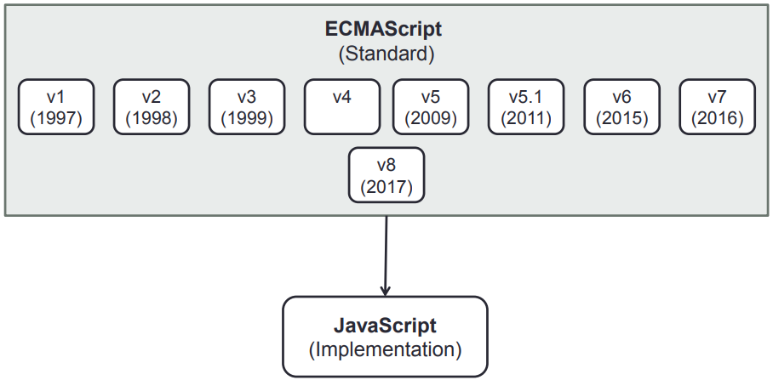
ES6: Evolution
The picture below depicts the evolution of ECMAScript over the years.

Slide 14
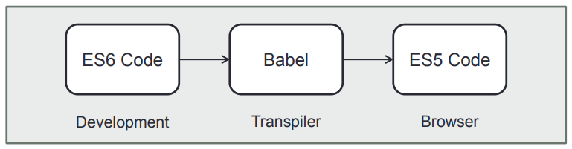
ES6: Under the Hood
The picture below shows how the ES6 code works under the hood.
Notes:
Babel is a JavaScript transpiler that converts edge JavaScript into plain old ES5 JavaScript that can run in any browser (even the old ones). It makes available all the syntactical sugar that was added to JavaScript with the new ES6 specification, including classes, fat arrows and multiline strings.

Slide 15
ES6 Features
Some popular ES6 features:
Array helper methods
Let and Const
Template literals
Arrow functions
Default function parameters
Rest and Spread
Destructuring
Classes
Promises
Modules
Fetch

Slide 16
Array Helper Methods

Slide 17
Array Helper Methods
Array helper methods work with collections of data.
They were built to avoid writing the classic for loop.
The different array helper methods are:
forEach()
map()
filter()
find()
every()
some()
reduce()
Notes:
Array helper methods were designed to make a set of operations we repeatedly find ourselves performing over arrays using for loops, faster. In the past, we had to have access to external libraries to use most of these methods. They were very popular and therefore it was decided to enter the ECMAScript standards. ECMAScript v5.1 standards came in year 2011 and these helper methods were drafted as part of that .Finally, these were codified in ECMAScript 6 (ES6).

Slide 18
Array Helper Methods: forEach()
Executes a provided function once for each array element
Has the syntax, array.forEach(iterator-function)
Code below iterates over the array names and will print Steve Chris Karen
var names = [‘Steve’, ‘Chris’, ‘ Karen’]
names.forEach(function(name) {
console.log(name)
});
Notes:
forEach accepts a function iterator that loop through each item in an array and performs a specified action on each element in the array. This code will print ‘Steve’, ‘Chris’ ‘Karen’ on the console.

Slide 19
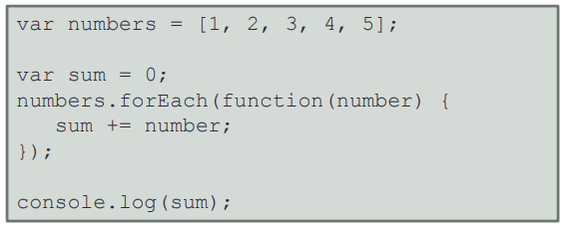
Array Helper Methods: forEach()
The forEach method will iteratively add each value in the array and the code will print 15.
Notes:
Here we initialize a variable, sum with 0, to hold the sum of all the values in the array numbers. The forEach method add each value in the array to the sum variable during each iteration. This code will print 15.

Slide 20
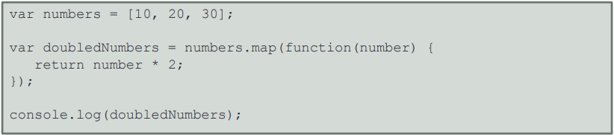
Array Helper Methods: map()
map() creates a new array with the results of calling a provided function.
It applies the function on every element in the calling array.
The code below will iteratively multiply each value in numbers and return a new array containing [20. 40. 60].
Notes:
Map will loop through the each item of array ,process and return new set of array. The variable doubledNumbers in the above code snippet will be array with values [ 20, 40, 60 ]

Slide 21
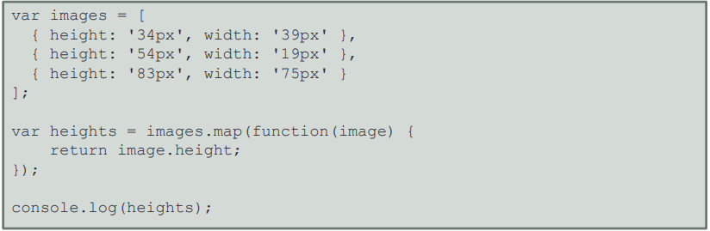
Array Helper Methods: map()
This code will create the array, heights, containing the height values of all the three objects in the images array.
Notes:
Here, we apply the map method on an array of objects, images. Each object has two attributes, height and weight. The code above will return an array containing th height values of all the three objects in the images array.

Slide 22
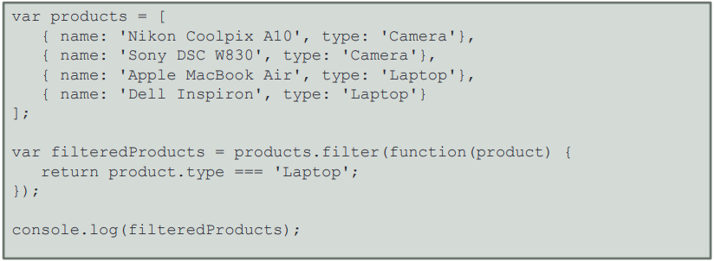
Array Helper Methods: filter()
The filter() method returns elements of an array that meet the condition specified in a callback function.
filteredProducts will have two objects from the products array where the type is Laptop.
Notes:
Here, the variable, filteredProducts will have two objects from the products array where the type meets the given filter i.e., Laptop.

Slide 23
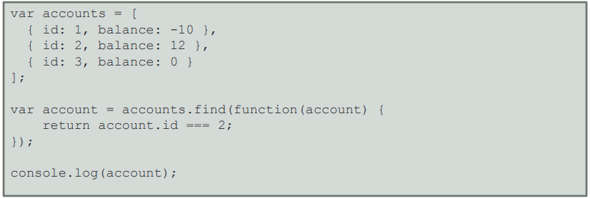
Array Helper Methods: find()
The find() method returns value of the first element in an array where predicate is true.
It returns undefined if no element meets the condition.
The code below will print “id: 2, balance: 12” as that’s the first element in accounts where id equals 2.
Notes:
Here, the variable account will contain the object with id 2 from the array, accounts.

Slide 24
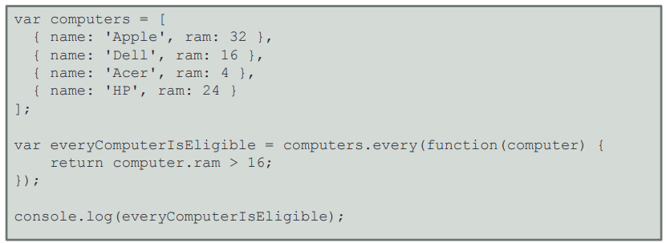
Array Helper Methods: every()
The every() method iterates through items of an array.
It checks if all items fulfill the specified condition and return a Boolean value.
The code below returns false as second and third objects in the array fail the test.
Notes:
The code above will return false, as the second and third objects in the array fails the test.

Slide 25
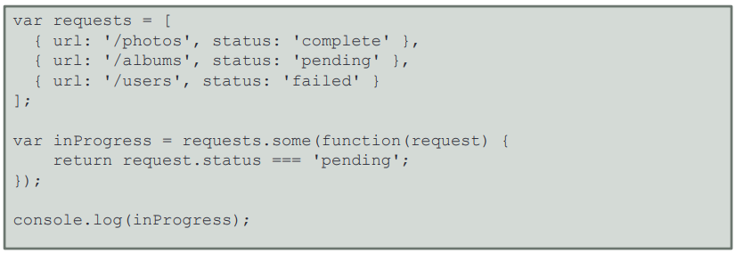
Array Helper Methods: some()
It is similar to every().
some() iterates through items of array, checks if any of the items fulfil the condition specified, and returns a Boolean value.
The code below will return true, as the second object in the array matches the test condition.
Notes:
The code above will return true, as the second object in the array matches the test condition.

Slide 26
Array Helper Methods: reduce()
reduce() is the most popular helper method.
All other helpers can be implemented using reduce().
It calls a specified callback function for all the elements in an array.
The callback returns the accumulated result which is also provided as an argument in the next call to the callback function.
It requires initial values for the accumulator function to be passed in.

Slide 27
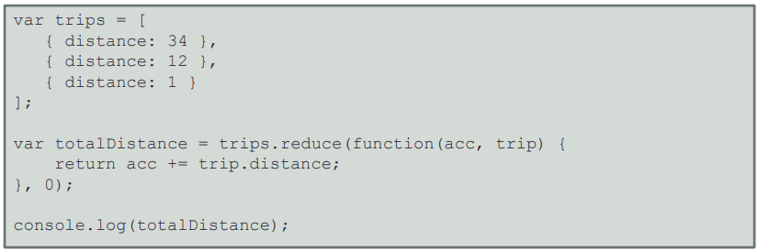
Array Helper Methods: reduce()
reduce() applies a function against an accumulator and each element in the array to reduce the array to a single value.
In the code below, we pass 0 as the initial value for the accumulator function.
Here, reduce() will return the sum of all distances stored in the accumulator variable.
Notes:
Applies a function against an accumulator and each element in the array (from left to right) to reduce it to a single value. Here we pass 0 as the initial value for the accumulator function.

Slide 28
Const and Let

Slide 29
Scope
Scope is the current context of execution.
It is the context in which values and expressions are visible or can be referenced.
If something isn’t in the current scope, then it is unavailable for use.
Scopes can be global or local.
Local scope is any scope defined after the global scope.
Notes:
There is only one global scope, and each function defined has its own local scope. Any function defined within another function has a local scope which is linked to the outer function.

Slide 30
Scope
Duration: 20 min.
Problem Statement: Demonstrate the scope of variables in JavaScript.

Slide 31
Assisted Practice: Guidelines
Steps to check the scope of variables in JavaScript:
Create a JavaScript file in your IDE.
Write a program with global and function-scoped variables in JavaScript.
Run the code.

Slide 32
Const
Constants are block scoped.
Value of a constant cannot be changed.
Constants cannot be redeclared.
The code below shows a constant being defined.
const name = ‘Sam’;
Notes:
Constants are block-scoped, much like variables defined using the let statement. The value of a constant can't be changed through reassignment, and it can't be redeclared.

Slide 33
Let
Declares a block scope local variable
Allows optional initialization
Has its own lexical this
Does not create properties of the window object when declared globally
Does not allow redeclaration
let age = 25;
Notes:
let allows you to declare variables that are limited to a scope of a block statement, or expression on which it is used.
Just like const the let does not create properties of the window object when declared globally

Slide 34
Let vs. Var
Are identical when used globally, that is, outside a function block or within function scope
Are similar but not identical, when used inside a function block
Differ when used in blocks
function letSample() {
//i is *not* visible out here
for( let i = 0; i < 5; i++ ) {
console.log(i)
}
//i is *not* visible out here
}
function varSample() {
//j *is* visible out here
for( var j = 0; j < 5; j++ ) {
console.log(j)
}
//j *is* visible out here
}
Notes:
“i” is only visible inside the for loop and in the for() parentheses and there is a separate “i” variable for each iteration of the loop.
“j” is visible in the entire function.
Assuming strict mode, var will let you re-declare the same variable in the same scope but let will not.

Slide 35
Let and Const
Duration: 20 min.
Problem Statement: Demonstrate the use of let and const in JavaScript.

Slide 36
Assisted Practice: Guidelines
Steps to define variables using let and const:
Create a JavaScript file in your IDE.
Write a program to demonstrate scope of variables in JavaScript.
Write a program to demonstrate different variable declarations used in JavaScript.
Run the code.

Slide 37
Template Literals

Slide 38
Template Literals
Are string literals
Allow embedded expressions
Are enclosed by the back-tick ( ` ` ) instead of single or double quotes
Contain placeholders (${expression})
Notes:
Template Literals are a new ES2015 / ES6 feature that allows you to work with strings in a novel way compared to ES5 and below.
The syntax is very simple, just use backticks instead of single or double quotes.
They provide a lot of features that normal strings built with quotes do not:
they offer a great syntax to define multiline strings.
they provide an easy way to interpolate variables and expressions in strings.
they allow you to create DSLs with template tags.

Slide 39
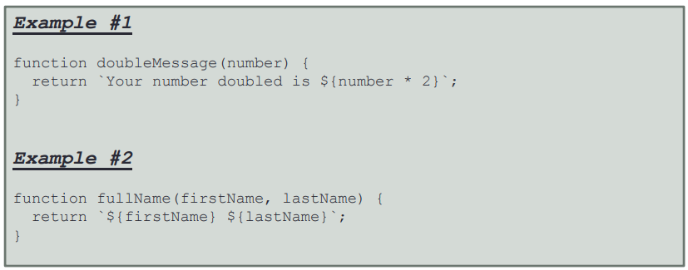
Template Literals
The code below shows template literals with placeholders or tagged template literals.

Slide 40
Template Literals
Duration: 20 min.
Problem Statement: Demonstrate the use of template literals in JavaScript.

Slide 41
Assisted Practice: Guidelines
Steps to use template literals in ES6:
Create a JavaScript file in your IDE.
Write a program that uses simple template literals, template literals with string interpolation, and tagged template literals in JavaScript.
Run the code.

Slide 42
Enhanced Object Literals

Slide 43
Enhanced Object Literals
Enhanced object literals are a shorthand for initializing properties and writing methods.
They are easy to write and read.
An enhanced object literal checks if the property key has a corresponding variable name and assigns the value of that variable to the property.
If no variable has the same name as the define property key, it’ll throw an error.
The : and function are no longer necessary to define a method.

Slide 44
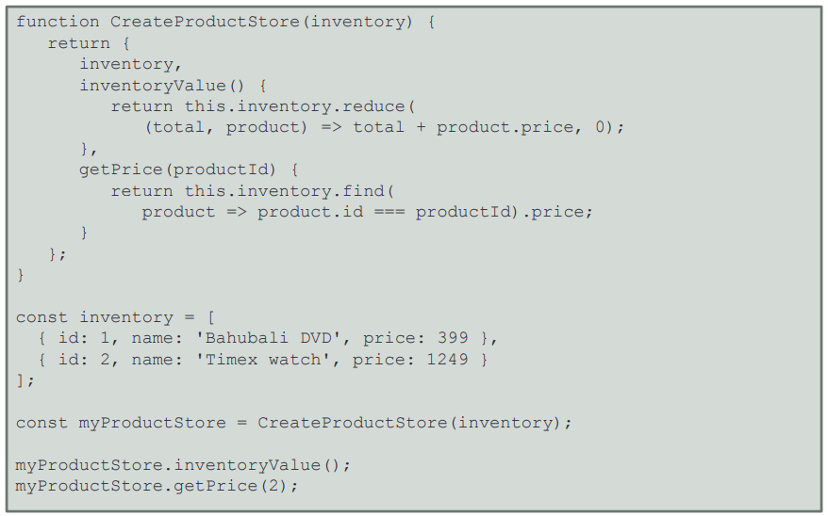
Enhanced Object Literals
The code below shows how to use enhanced object literals.

Slide 45
Default Function Arguments

Slide 46
Default Function Arguments
Default function arguments speed up your development and make the code better organized.
Default parameters allow to initialize functions with default values.
A default is used when an argument is either omitted or undefined.
A default parameter can be anything, from a number to another function.

Slide 47
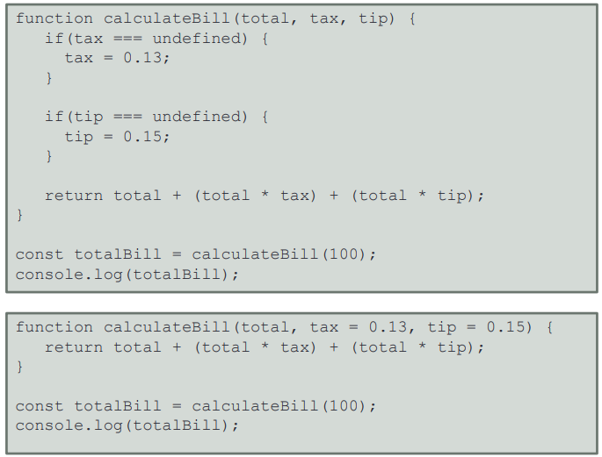
Default Function Arguments
The code below shows a function defined with and without default arguments.
If the first calculateBill is invoked without passing in a value for tax or tip, it’ll throw an error.
If the second function is invoked without passing in values of tax and tip, it’ll just use 0.13 and 0.15.

Slide 48
Default Function Arguments
Duration: 20 min.
Problem Statement: Demonstrate the use of default function arguments in JavaScript.

Slide 49
Assisted Practice: Guidelines
Steps to demonstrate the use of default function arguments:
Create a JavaScript file in your IDE.
Write a function that uses default functions arguments in JavaScript.
Run the code.

Slide 50
Rest and Spread

Slide 51
Rest
Rest lets you represent an indefinite number of arguments as an array.
Rest collects multiple elements and condenses them into a single element.
A function's last parameter can be prefixed with ... to place all user-supplied arguments within a JavaScript array.
Only the last parameter can be a rest parameter.
Notes:
There are three main differences between rest parameters and the arguments object:
only the parameters that haven't been formally defined in function expression are rest, while the arguments object contains all arguments passed to the function;
the arguments object is not a real array, while rest parameters are Array instances, meaning methods like sort, map, forEach or pop can be applied on it directly;
the arguments object has additional functionalities like the callee property.

Slide 52
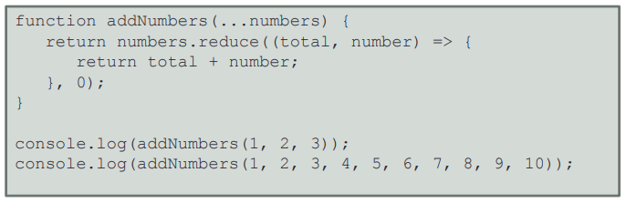
Rest
The first invocation statement in the code below will cause numbers to have three items in it.
The second invocation will cause numbers to have ten items in it.
Rest allows the function, addNumbers, to work with a varied number of arguments using the same code.

Slide 53
Rest
Duration: 20 min.
Problem Statement: Demonstrate the use of rest in JavaScript.

Slide 54
Assisted Practice: Guidelines
Steps to demonstrate rest:
Create a JavaScript file in your IDE.
Write a program with functions that use arguments defined with rest in JavaScript.
Run the code.

Slide 55
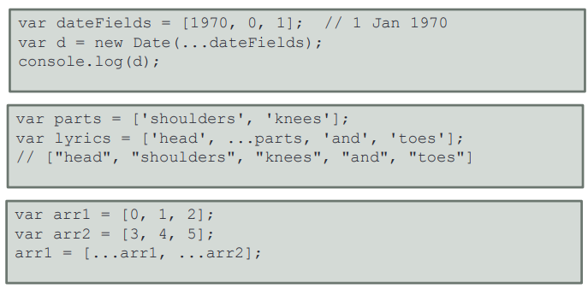
Spread
Spread expands an array into its elements.
In the code blocks below, dateFields, parts, arr1, and arr2 can dynamically take as many arguments as needed in runtime.
Notes:
Spread syntax allows array expression or string to be expanded in places where zero or more arguments (for function calls) or elements (for array literals) are expected

Slide 56
Spread
Duration: 20 min.
Problem Statement: Demonstrate the use of spread in JavaScript.

Slide 57
Assisted Practice: Guidelines
Steps to demonstrate spread:
Create a JavaScript file in your IDE.
Write a program with functions that have arguments using spread in JavaScript.
Run the code.

Slide 58
Destructuring

Slide 59
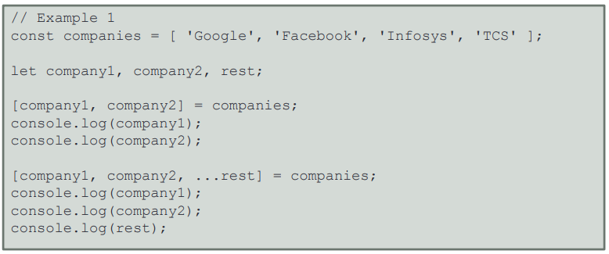
Destructuring
Destructuring unpacks values from arrays or properties from objects into distinct variables.
In the code below, values from the array, companies, are being extracted into the variables company1, company2, and rest.
Notes:
With destructuring, you can now extract data from arrays and objects and assign them to variables.

Slide 60
Destructuring
// Example 2
let customer = {
name:‘Steve’,
age:23,
email:‘steve.stark@xyz.com’
};
let {name, email} = customer;
console.log(name);
console.log(email);
Values of the fields, name and email, in the object customer is being extracted into variables, name and email.
Destination variables should have the same name as the object property for object destructuring.

Slide 61
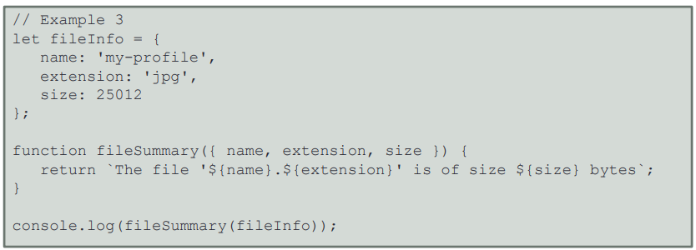
Destructuring
In the code below, we use object destructuring to extract values of the fields, name, extension, and size of the object fileInfo into variables.

Slide 62
Destructuring
Duration: 20 min.
Problem Statement: Demonstrate destructuring in JavaScript.

Slide 63
Assisted Practice: Guidelines
Steps to demonstrate destructing:
Create a JavaScript file in your IDE.
Write programs that extract values from arrays into variables in JavaScript.
Write programs that extract values from objects into variables in JavaScript.
Run the code.

Slide 64
Arrow Functions

Slide 65
Arrow Functions
Are similar to regular functions in behavior but have shorter syntax
Are also known as fat arrow functions
Do not have their own this keyword
Use this keyword of the enclosing execution context
Notes:
If your function is in a block, you must also use the explicit return statement.
If you are returning an object literal, it needs to be wrapped in parentheses. This forces the interpreter to evaluate what is inside the parentheses, and the object literal is returned.
Harder to debug: When you get an error, you will not be able to trace the name of the function or the exact line number where it occurred.
No self-referencing:If your function needs to have a self-reference at any point (e.g. recursion, event handler that needs to unbind), it will not work.
Main benefit: No binding of ‘this’

Slide 66
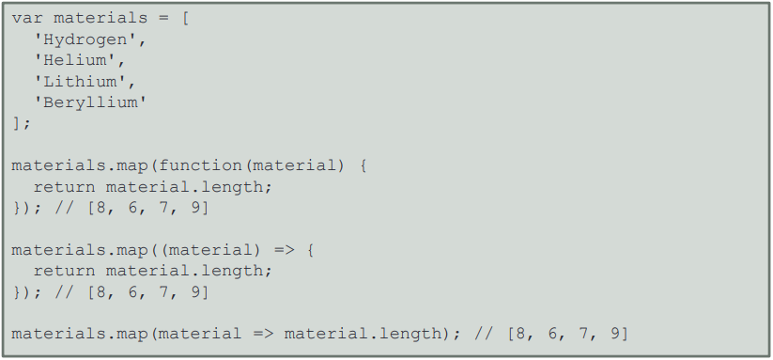
Arrow Functions
The code below shows three map functions with different syntax to get lengths of elements in the array, materials.
The first map uses the traditional syntax.
The second map uses the arrow function syntax.
The third map uses the shortest arrow function syntax, omitting the function and the return statements.

Slide 67
Arrow Functions
Duration: 20 min.
Problem Statement: Demonstrate the use of arrow functions in JavaScript.

Slide 68
Assisted Practice: Guidelines
Steps to write a JavaScript function using arrow functions:
Create a JavaScript file in your IDE.
Write a program with functions using different types of arrow functions in JavaScript.
Run the code.

Slide 69
Classes

Slide 70
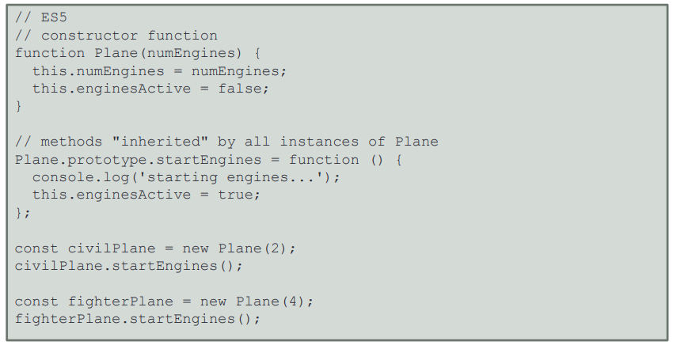
Classes
Traditionally, we used functions to create objects in JavaScript.
Traditional JavaScript used prototypal inheritance to inherit data and functionality.
ES6 introduced the keywords, class, super, and extends.
The code below shows a function named Plane with attributes, numEngines and enginesActive, and method startEngines, in ES5 style.

Slide 71
Classes
JavaScript classes are primarily syntactic sugar
They do not introduce a new object-oriented inheritance model to JavaScript
They are defined over JavaScript's existing prototype-based inheritance
All the code that's needed for the class is contained in the class declaration
Classes make code short and clean
They’ve a special method named Constructor() that initializes new objects
The class syntax has two components: class expressions and class declarations

Slide 72
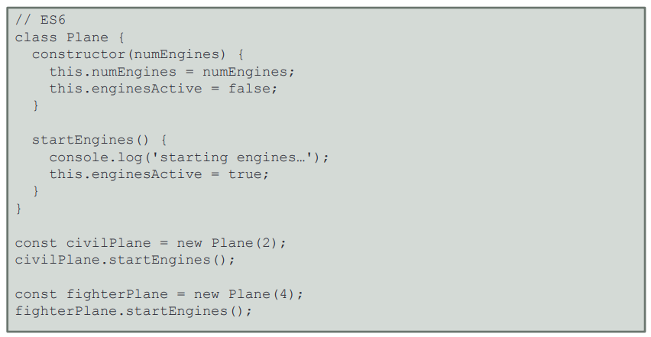
Classes
You use the class keyword with the name of the class to declare a class.
The code below shows a class named Plane with attributes, numEngines and enginesActive, and method startEngines, in ES6 style.
Notes:
An important difference between function declarations and class declarations is that function declarations are hoisted and class declarations are not. You first need to declare your class and then access it, otherwise it will throw a ReferenceError.
A class expression is another way to define a class. Class expressions can be named or unnamed. The name given to a named class expression is local to the class's body. (it can be retrieved through the class's (not an instance's) name property, though).

Slide 73
Classes
Duration: 20 min.
Problem Statement: Demonstrate the use of classes in JavaScript.

Slide 74
Assisted Practice: Guidelines
Steps to implement classes:
Create a JavaScript file in your IDE.
Write a program that defines classes in JavaScript.
Run the code.

Slide 75
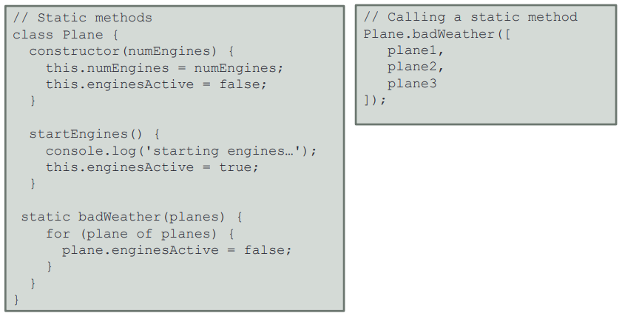
Classes: Static Methods
The static keyword defines a static method for a class.
The method name is prefixed with the keyword, static, to define a static method.
Static methods are called without instantiating their class and cannot be called through class instance.
The code below shows a static method badWeather being added to the class Plane.

Slide 76
Static Methods
Duration: 20 min.
Problem Statement: Demonstrate the use of static methods in JavaScript.

Slide 77
Assisted Practice: Guidelines
Steps to demonstrate static methods:
Create a JavaScript file in your IDE.
Write a program that defines static methods in a class and invokes them with a class object.
Run the code.

Slide 78
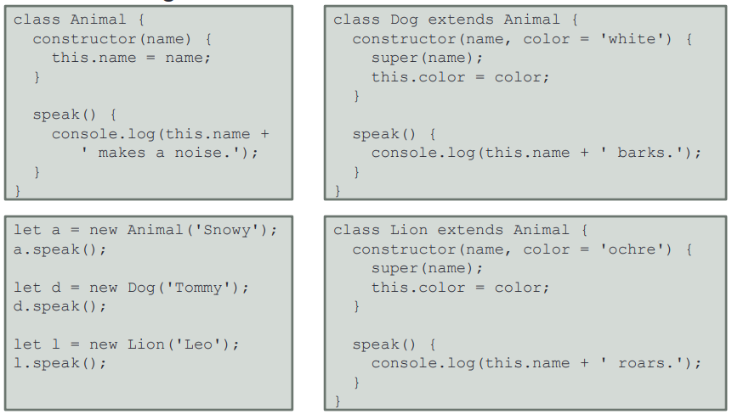
Classes: Inheritance
The extends keyword offers subclassing functionality.
Subclassing has less setup code and provides a clean syntax.
In the code below, classes Dog and Lion are inherited from the superclass Animal.
Notes:
If there is a constructor present in the subclass, it needs to first call super() before using "this".
You can also extend traditional function-based "classes".
Classes cannot extend regular (non-constructible) objects.

Slide 79
Inheritance
Duration: 20 min.
Problem Statement: Demonstrate the implementation of inheritance in JavaScript.

Slide 80
Assisted Practice: Guidelines
Steps to demonstrate inheritance:
Create a JavaScript file in your IDE.
Write a program that uses classes inherited from a parent class.
Run the code.

Slide 81
Generators

Slide 82
Generators
Generators are functions that can be exited and later reentered.
They maintain context across reentries.
They are defined using function* declaration.
They can be used to iterate through any data structure.
The yield keyword pauses generators and sends data outside the generator.
The .next() method passes data into generators.
Calling a generator function does not execute its body immediately but returns an iterator object.
When the iterator's next() method is called, the generator function's body is executed until the first yield expression.
Notes:
yield expression can optionally specify the value to be returned from the iterator
• The next() method returns an object with a value property containing the yielded value
• A boolean property, done indicates whether the generator has yielded its last value.
• Calling the next() method with an argument will resume the generator function execution, replacing the yield expression where execution was paused with the argument from next()
• A return statement in a generator, when executed, will mark the generator done.

Slide 83
Promises

Slide 84
Promise
The promise object represents the eventual completion of an asynchronous operation and its resulting value
It lets you run asynchronous jobs in the background
It’s natively implemented in ES6
There are three different promise states: pending, resolved, and rejected
Pending: Waiting for a long running task to finish
Resolved: Task successful
Rejected: Task failed
Notes:
A Promise is a proxy for a value not necessarily known when the promise is created. It allows you to associate handlers with an asynchronous action's eventual success value or failure reason. This lets asynchronous methods return values like synchronous methods: instead of immediately returning the final value, the asynchronous method returns a promise to supply the value at some point in the future.

Slide 85
Promise
Popular methods: resolve(value), reject(reason), then(onFulfilled, onRejected), and catch(onRejected)
resolve(value): Is called on successful request completion
then(onFulfilled, onRejected): Appends fulfillment and rejection handlers to the promise
catch(onRejected): Appends a rejection handler callback to the promise
Other methods:
all(iterable): Waits for all promises to be resolved or some to be rejected
allSettled(iterable): Waits until all promises have settled, that is, either be resolved or rejected
race(iterable): Waits until any of the promises is resolved or rejected

Slide 86
Promises
Duration: 20 min.
Problem Statement: Demonstrate the use of promises in JavaScript.

Slide 87
Assisted Practice: Guidelines
Steps to demonstrate promises:
Create a JavaScript file in your IDE.
Write a program that uses promises to perform asynchronous tasks in JavaScript.
Run the code.

Slide 88
Fetch

Slide 89
Fetch
API for accessing and manipulating parts of the HTTP pipeline such as requests and responses
Previously achieved using XMLHttpRequest
Easy and logical way to fetch resources asynchronously across the network
Promise based
Notes:
The fetch specification differs from jQuery.ajax() in two main ways:
The Promise returned from fetch() won’t reject on HTTP error status even if the response is an HTTP 404 or 500. Instead, it will resolve normally (with ok status set to false), and it will only reject on network failure or if anything prevented the request from completing.
By default, fetch won't send or receive any cookies from the server, resulting in unauthenticated requests if the site relies on maintaining a user session (to send cookies, the credentials init option must be set).

Slide 90
Modules

Slide 91
Modules
Introduced to create a format that can be used by both CommonJS and AMD users
The ES6 module standard has two parts, declarative syntax and programmatic loader API
Declarative syntax: To import and export
Programmatic loader API: To define how modules are loaded and to conditionally load them

Slide 92
Modules: Exports
Types of exports: Named exports and default exports
Named exports: Export multiple things by prefixing their declarations with the keyword export
Default exports: Only export single values
Styles of default exports: Labeling declarations and default-exporting values directly

Slide 93
Modules: Imports
Imports are read-only views on exports.
Imports and exports must be at the top level.
Module imports are hoisted, that is, internally moved to the beginning of the current scope.
Imports are designed with support for cyclic dependencies.
Notes:
Two modules A and B are cyclically dependent on each other if both A imports B and B imports A.

Slide 94
Import and Export Modules
Duration: 20 min.
Problem Statement: Demonstrate the use of import and export modules in JavaScript.

Slide 95
Assisted Practice: Guidelines
Steps to demonstrate importing and exporting modules:
Create a JavaScript file in your IDE.
Write a program that imports and exports modules in JavaScript.
Run the code.

Slide 97
Which of this is not a new feature introduced by ES6?
1
Promises
Object literals
Classes
Fat arrow functions

Slide 98
Which of this is not a new feature introduced by ES6?
1
Promises
Object literals
Classes
Fat arrow functions
b
Object literals have been a part of JavaScript since ES3. ES6 introduced Enhanced Object Literals.

Slide 99
Which of the following is a difference between Let and Var?
2
Let allows redeclaration but var doesn’t.
You cannot use let to declare global variables. Only var declares global variables.
Variables declared with let cannot be accessed before they are declared in their enclosing block.
Var is supported by Google Chrome but let isn’t.

Slide 100
Which of the following is a difference between Let and Var?
2
Let allows redeclaration but var doesn’t.
You cannot use let to declare global variables. Only var declares global variables.
Variables declared with let cannot be accessed before they are declared in their enclosing block.
Var is supported by Google Chrome but let isn’t.
c
Let is block scoped and variables declared with let cannot be accessed before they are declared in their enclosing block.
Notes:
Let doesn’t allow redeclaration but var does in strict mode.
Both var and let have global scope when
Chrome supports let but only if you declare use strict in the beginning.

Slide 101
Which of the following statements is true about promises?
3
A promise is the object of an asynchronous function.
A promise is a container for a future value.
A promise suspends the execution of all other functions until the async function is executed.
If a promise is unresolved, it will return a null value.

Slide 102
Which of the following statements is true about promises?
3
A promise is the object of an asynchronous function.
A promise is a container for a future value.
A promise suspends the execution of all other functions until the async function is executed.
If a promise is unresolved, it will return a null value.
b
A promise is an object that is used as a placeholder for the eventual results of an asynchronous computation. It is a container that will be populated with a value in the future when the asynchronous function finishes execution.
Notes:
Asynchronous functions have function objects. A promise is not the same as the object of the asynchronous function.
A promise lets you run your tasks while the asynchronous function runs in the background.
If a promise is unresolved, it returns the reason for t

Slide 103
ES6 introduced array helper methods
Let can be used to declare block-scoped variables
Rest allows array and object destructuring in JavaScript
Classes, promises, and modules are available in ES6

